Slide 1
Future of Blockchain
By Paras Dalal

Slide 2
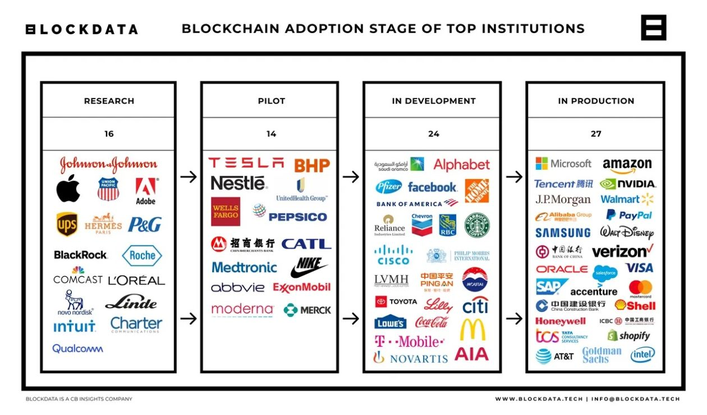
Who ?
Notes:
In 2014 only 2 companies were using Blockchain – Paypal & Walt Disney
By year 2021, 81 out of top 100 US companies (by market capitalization) are using it

Slide 3
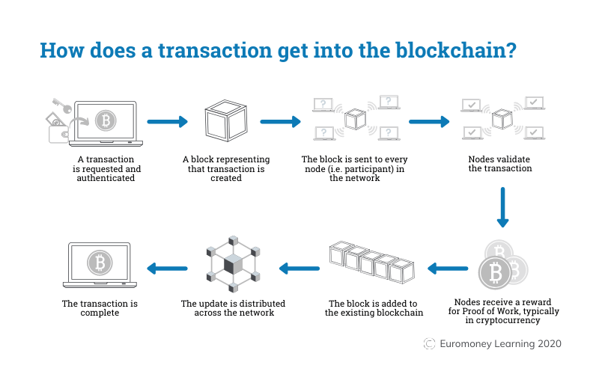
What/How?
https://demoblockchain.org/blockchain

Slide 4
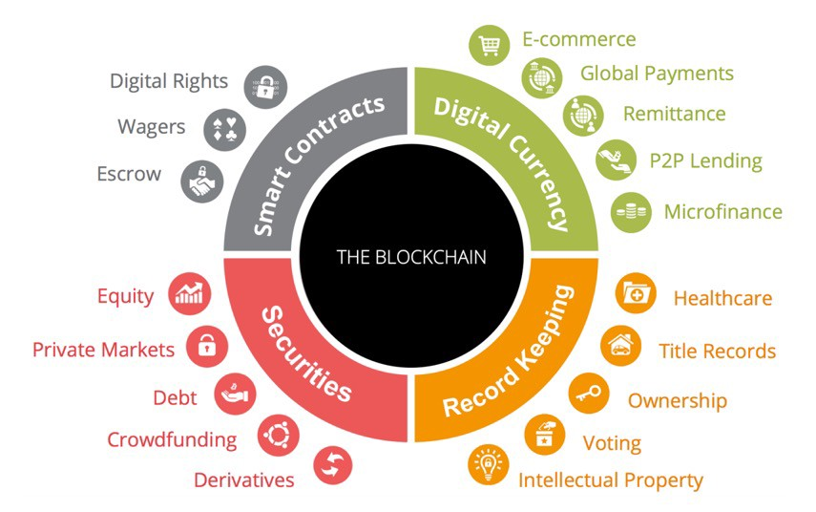
WHY ?
Notes:
Digital currency – Strong security, immutability
Record keeping – Immutability, Large distributed network
Securities – Storage of value
Smart contracts – Instant transaction, All parties on the same page, Bound by digital signatures

Slide 5
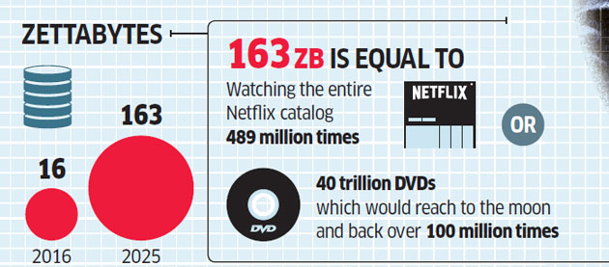
Example: Large Data
Data Overflow
1,000,000,000,000,000,000,000 (10²¹ = 1 Billion Terabytes)
Notes:
Example is FileCoin (Sia.tech)

Slide 6
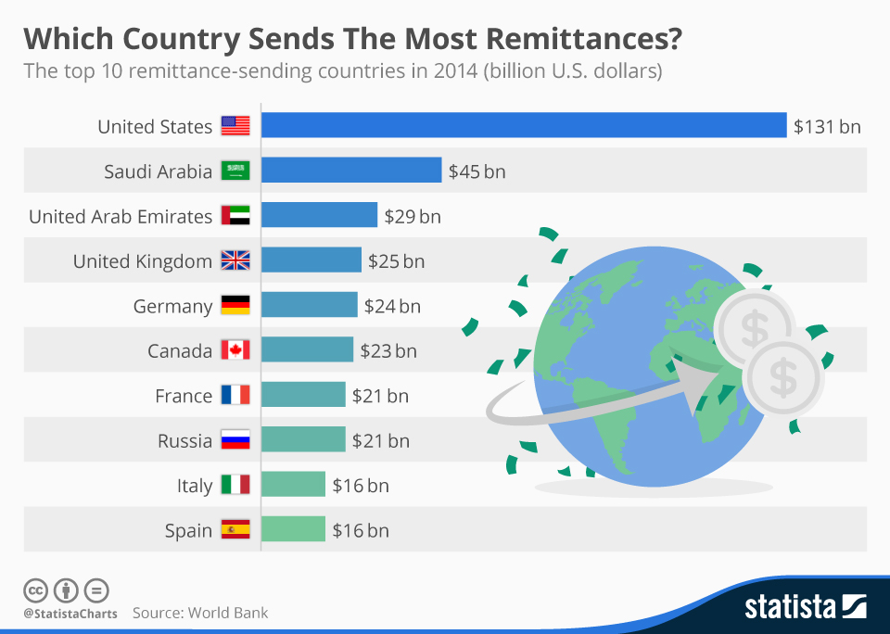
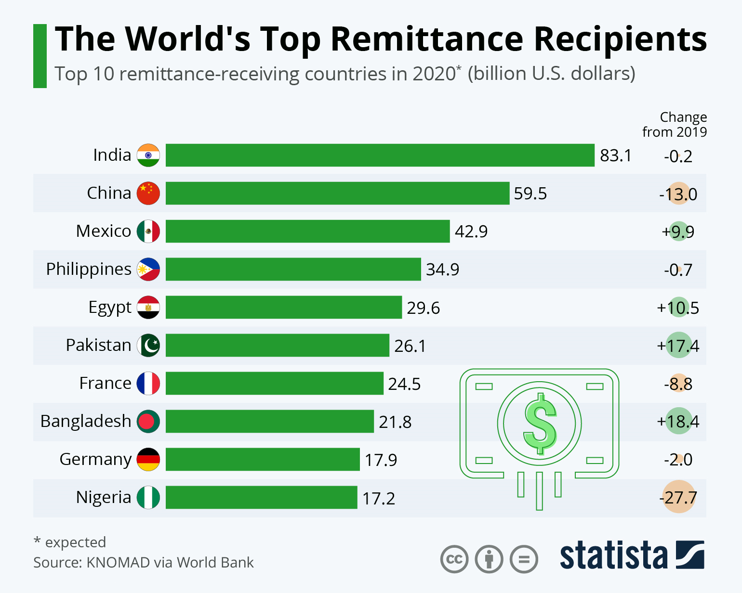
Example: International Transactions
Notes:
Slowness because of central agencies (Multiple ledgers to be updated)
How to avoid problem of double spend
Personal experience of sending money

Slide 7
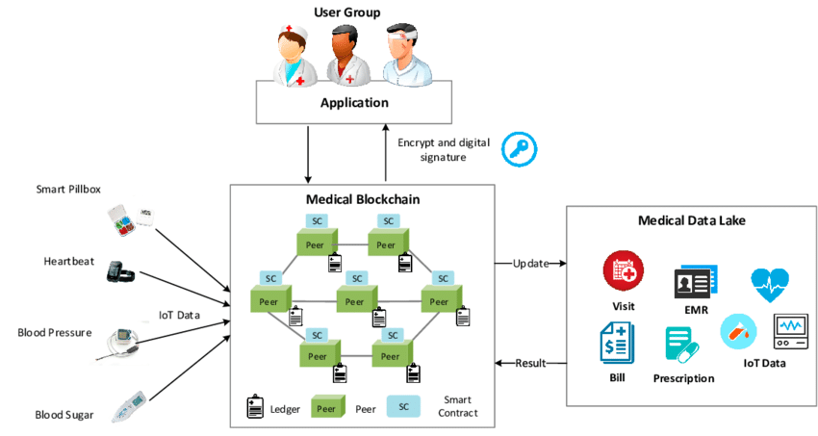
Example: Medical Records
Notes:
Use case – Change of doctor, need while on vacation

Slide 8
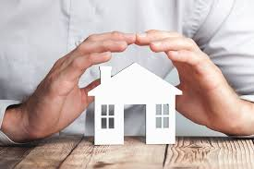
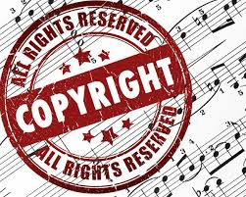
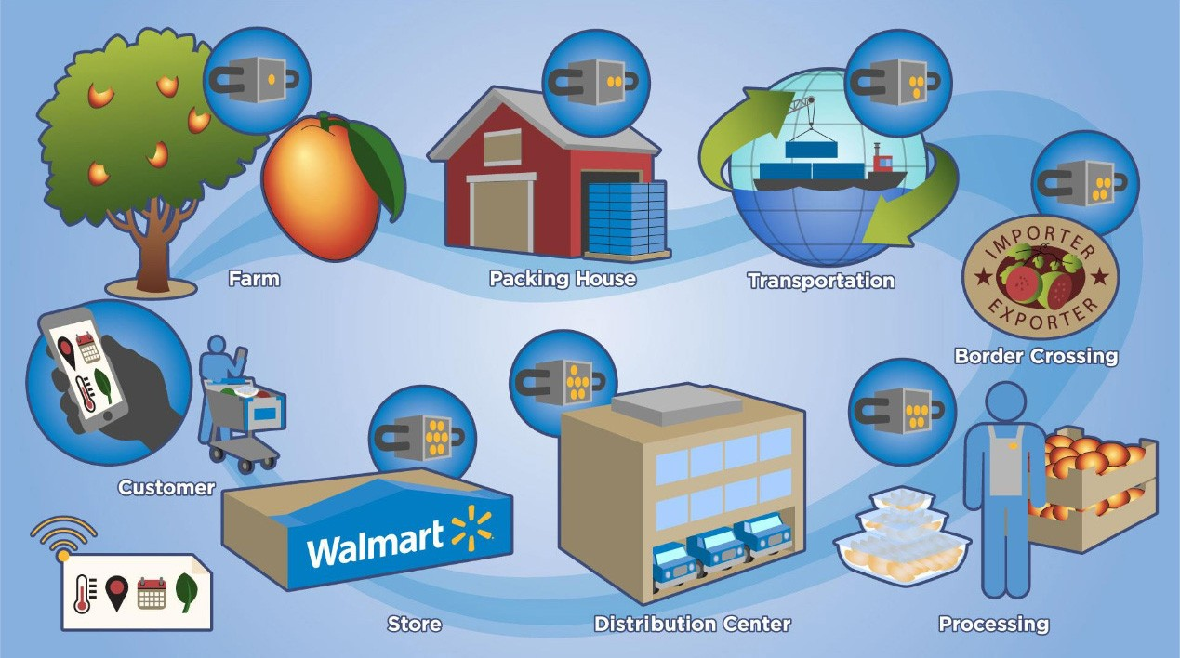
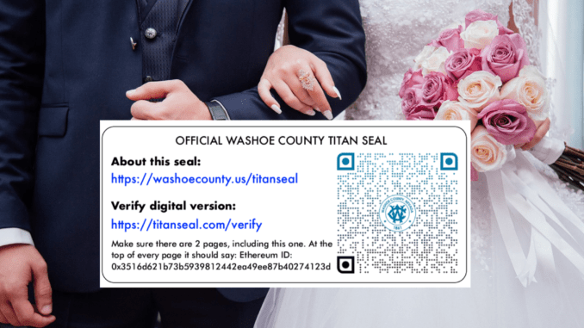
OTHER Samples
Notes:
Copyrighted music distribution (avoid piracy – smart contract – Front loaded, written in code
Real estate title insurance via decentralized title registry
Marriage licenses via smart contract (Reno – State of Nevada)
Supply chain with transparency of origin (Walmart) – started in 2016. Origin information from 6 days to 3 seconds
Tracking of shipments (DHL)

Slide 9
Problems of Blockchain
Immutability
Cost of transaction
Scalability
Vulnerability
Anonymity
Governance
Notes:
Immutability – Errors not allowed – cannot modify any transaction
Cost - Proof of work requires vast amount of computing power and electricity
Scalability - Large blockchain makes the speed of transactions slow (7 bitcoin tran vs 1700 visa/5000 mastercard per second)
Vulnerability – Private key is the strength and the weakness
Anonymity – Who is Satoshi Nakamoto?
Governance - Lack of governance due to early stage of technology
Majority stakeholder in mining can alter transactions

Slide 10
Relevance to Bessemer
May need to participate in various public blockchains
E.g. Zero day settlement using smart contracts
Crypto positions of our clients
May need to have private blockchain to reflect in our books
Speed of getting data to client
Private blockchain at our regional offices with historical data
Our clients may invest into digital assets
We need to be aware of underlying technology to guard their interests

Slide 11
Future ?
Self driving transactions
Increased transparency
All kind of information available via blockchain
Data secured by DNA
Metaverse as rich as real world
Pillar for better things
Notes:
Smart contracts – eSignatures, payments
DNA acting as private key – you don’t lose it
Metaverse – your avatar(s) interacting as you – you can be a kid and a sage at the same time
Pillar – Crypto, NFTs, IoT processing, Virtual reality

Slide 12


